Slide 1
BUS PASS MANAGEMENT SYSTEM
BY :SHREYITH
: RANITH

Slide 2
INTRODUCTION
A bus pass management system is a system used to manage and track the use of bus passes by passengers.
It typically includes a system for issuing and activating passes, as well as monitoring and enforcing their use on buses. It may also include features such as fare collection, route tracking, and passenger counting.
The goal of a bus pass management system is to improve the efficiency and convenience of transportation for students.

Slide 3
OBJECTIVES
The objectives of a bus pass management system:
Improved efficiency and convenience for student: By issuing and activating bus passes electronically,
Electronic bus passes can help reduce costs associated with printing and distributing paper tickets, as well as reduce the need for staff to handle cash.
It also help reducing paper waste, in the long term, as it can be used to replace paper bus passes with electronic ones, which are more sustainable.

Slide 4
SCOPE
The scope of a bus pass management system is
Pass Issuance: The system should have the capability to issue and activate bus passes electronically, either through a web portal or through a mobile app.
The system should be able to track the number of students on a bus, and provide data on students counts and travel patterns.
The system should have an easy-to-use and intuitive interface for both students and admin

Slide 5
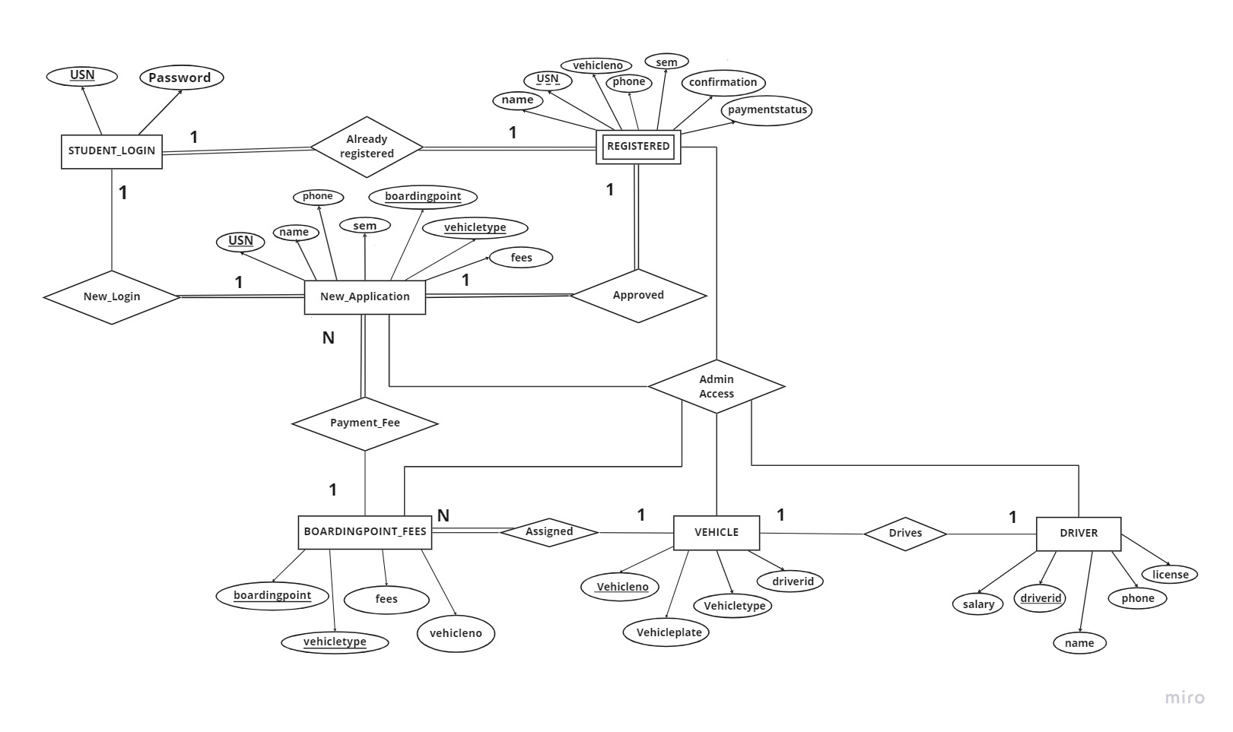
ER DIAGRAM

Slide 6
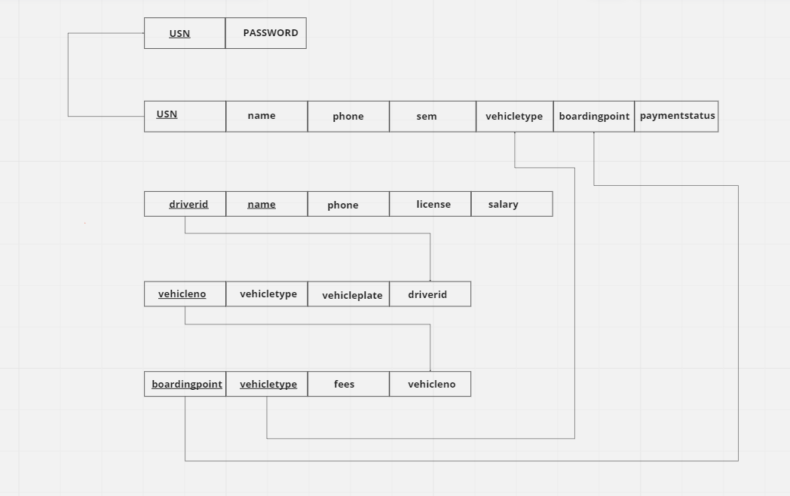
SCHEMA DIAGRAM
STUDENT_LOGIN
REGISTERED
DRIVER
VEHICLE
BOARDINGPOINT_FEES

Slide 7
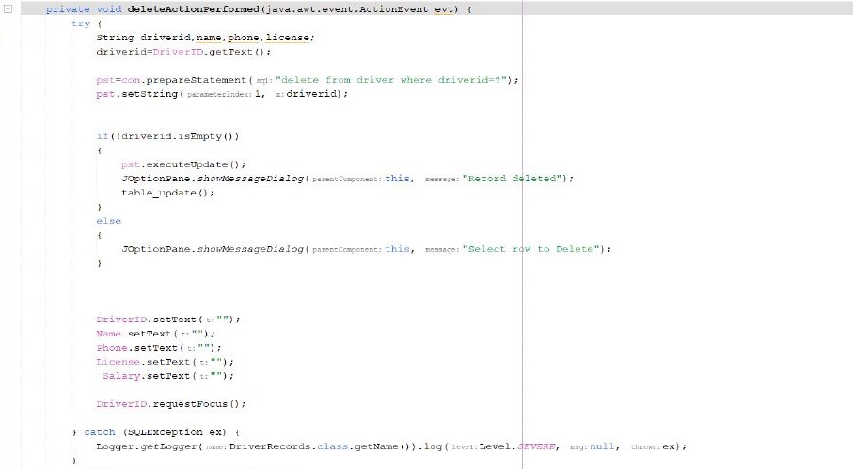
SOME PARTS OF CODE

Slide 8
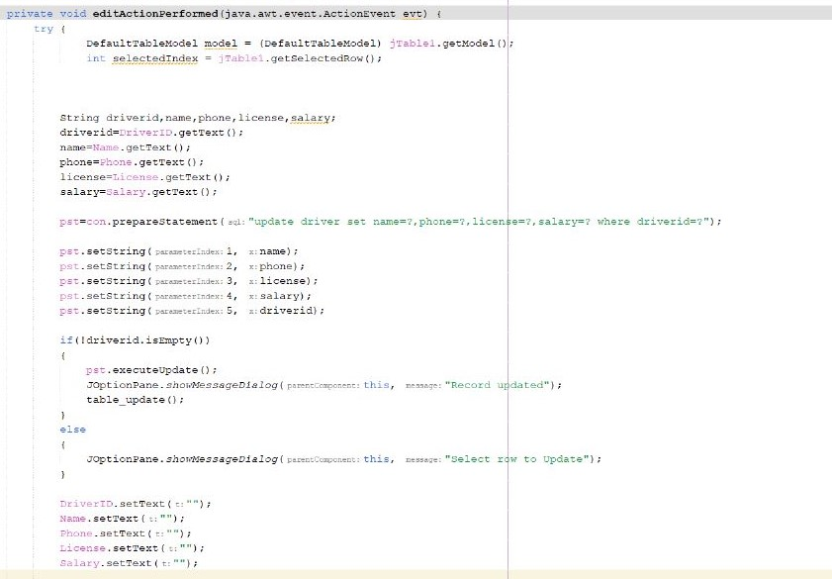

Slide 9
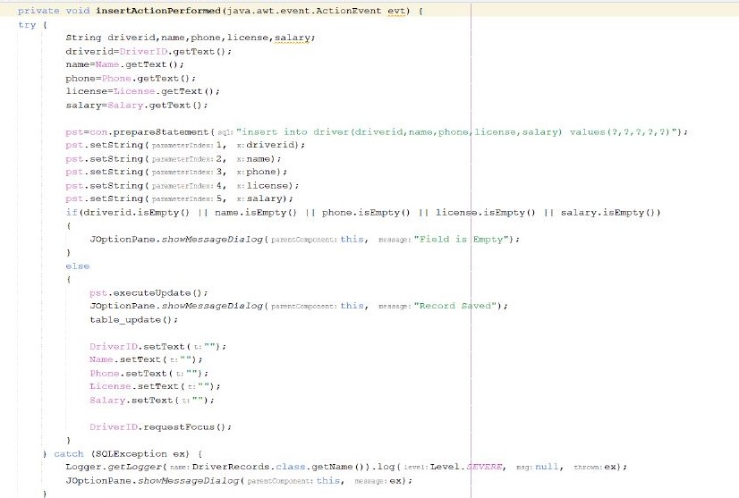

Slide 10
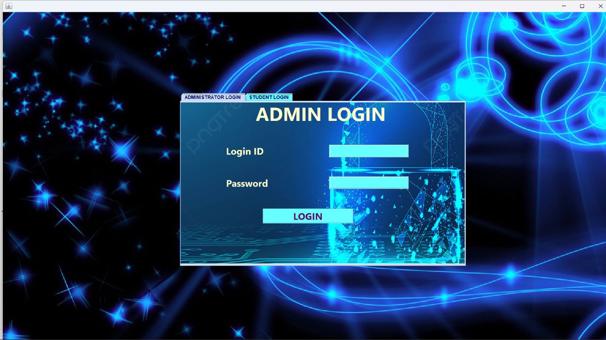
SYSTEM UI

Slide 11
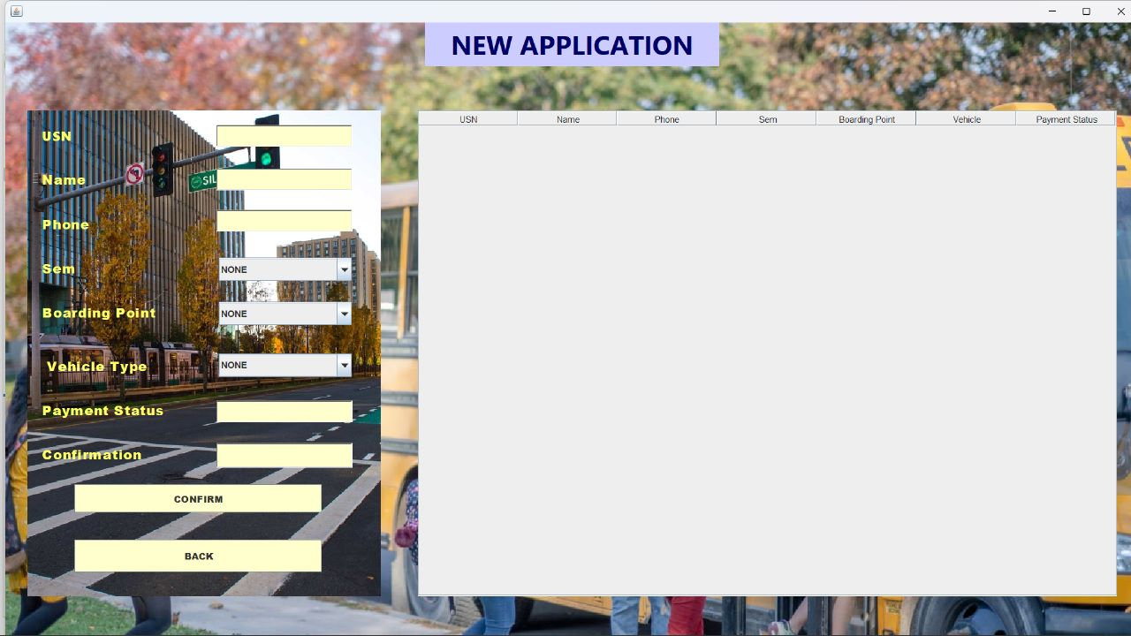

Slide 12
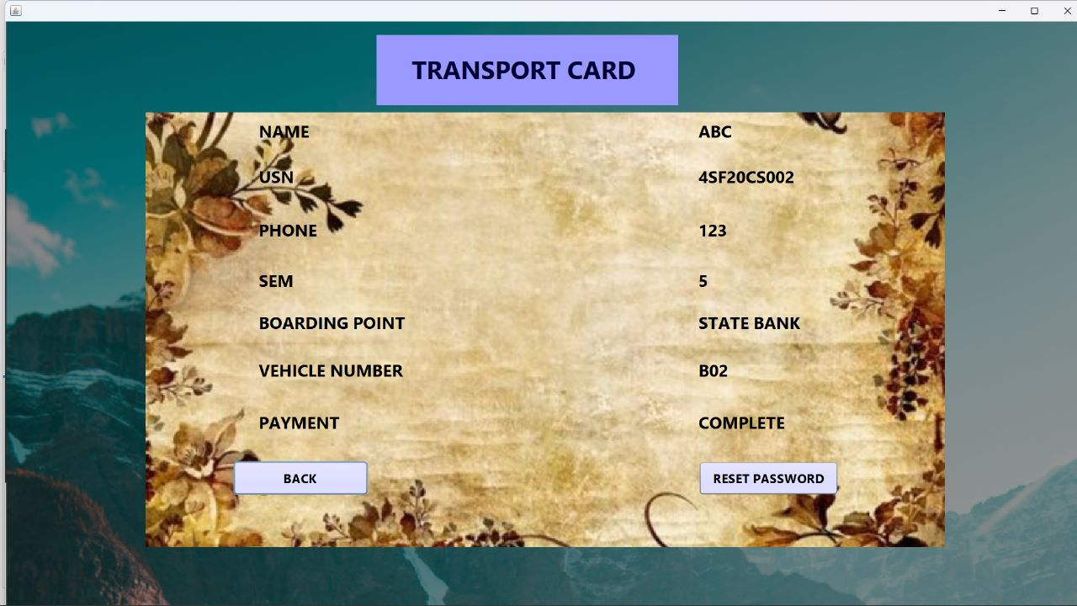

Slide 13
OUTCOME
The outcome of a college bus pass management system can vary depending on the specific needs and requirements of the college or university, but some common outcomes include:
Increased efficiency and convenience for students: By issuing and activating bus passes electronically, students can board buses more quickly and easily, without the need to carry cash or wait in line to purchase tickets.
Better data and insights: By collecting data on student travel patterns, the college or university can gain valuable insights into how to improve their bus services and make better-informed decisions.

Slide 14
RESULTS
The results of a college bus pass management system can vary depending on the specific needs and requirements of the college or university, but some common results include:
Improved record keeping With the system in place, the college or university can maintain accurate records of the bus usage and fare collection, which can be used for accounting and budgeting purposes.
Successful implementation of the system The college bus pass management system is implemented and made available for use by students and staff.

